Slide 1

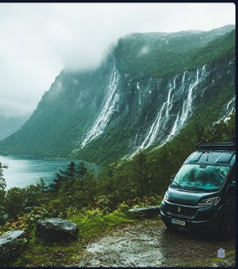

Voyago: Explore Beyond Borders
Travel Agency Web Platform
S.V. Suhaas
Sai University, Chennai
2026 Capstone Project

Slide 2

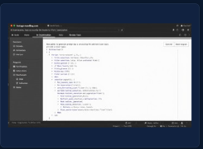
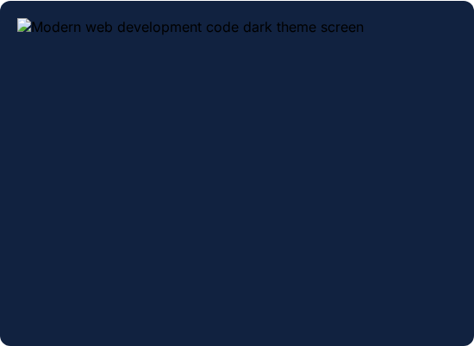
Project Overview
India-based travel agency site.
Built with HTML, CSS, JS.
Deployed live on Netlify.
Comprehensive college project.

Slide 3






Core Website Features
Structure
Interactive
Usability
Multi-page & fully responsive.
Booking forms & live chat.
FAQ accordion & user login.

Slide 4
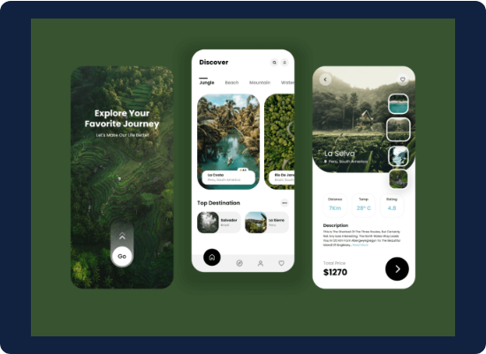
Design & UX
Mobile-first responsive layout.
Smooth scroll-reveal animations.
Accessible images and links.
Navy, gold, teal palette.

Slide 5



SEO Optimization
Targeted meta tags included.
Canonical URLs prevent duplication.
Schema.org JSON-LD added.
Sitemap and robots.txt configured.

Slide 6




Generative Engine Optimization (GEO)
AI Crawlers
Content Parsing
Included llms.txt for AI bots. Structured data fully optimized.
Reduced JavaScript reliance. Raw HTML prioritized for scraping.

Slide 7
Performance Optimization
Images lazily loaded.
95+
JavaScript execution deferred.
DNS prefetch active.
Lighthouse Score
Brotli compression enabled.

Slide 8






Security & Privacy
Anti-Spam
Encryption
Data Integrity
JS email obfuscation protects contacts.
Strict HTTPS/SSL protocol enforcement.
Robust frontend form validation.

Slide 9
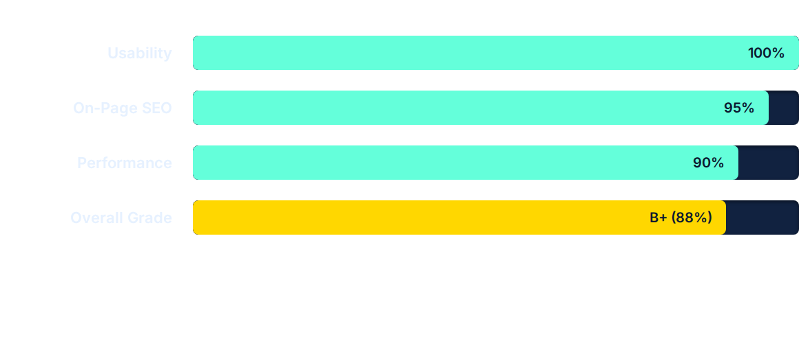
Final Audit Results
Post-optimization audits on SEOptimer showed a significant leap from a base B grade to a strong B+, confirming the success of our technical optimizations.

Slide 10



Challenges & Learnings
Technical Growth
Trade-offs
Future Roadmap
Mastered modern SEO and GEO basics.
Balanced smooth UX with crawlability.
Planned backlinks and social presence.

Slide 11



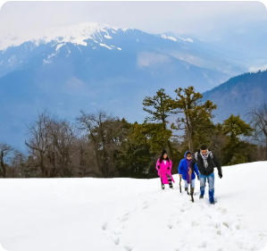
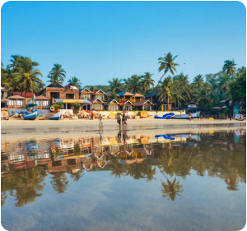

Platform Previews
Manali Adventure
Goa Beach Escape
Kerala Backwaters

Slide 12

Thank You
Open for questions and feedback.
github.com/suhaas
suhaas.sarabu@gmail.com

